Slide 1

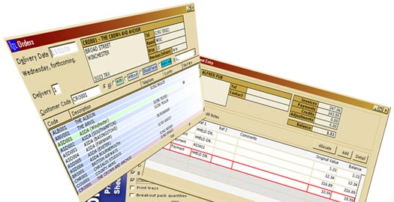

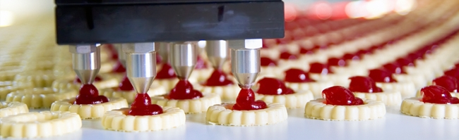
Web base Ordering & Manufacturing Management System
Project Proposal Presentation
Miss. Nontra Mahachanont 542115026
Mr. Parinya Panyanak 542115034

Slide 2
Agenda
Introduction
Problems
System review
Technology review
Development tools review
System Architecture
Limitation
Quality Assurance
Objectives
Development Model
Schedule and Milestones

Slide 3






Where the Idea from ?
Order
Order
Order
Order
Order
Order

Slide 4
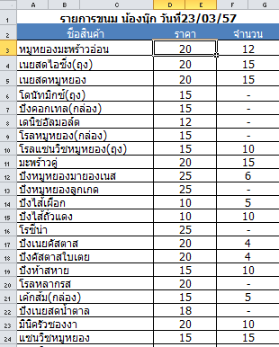


Slide 5



Problems
Mistake ordering information
order
Wholesaler A
order
Wholesaler B
order
Wholesaler C

Slide 6



Wholesaler cannot edit order after submitted
Manufacturer

Slide 7
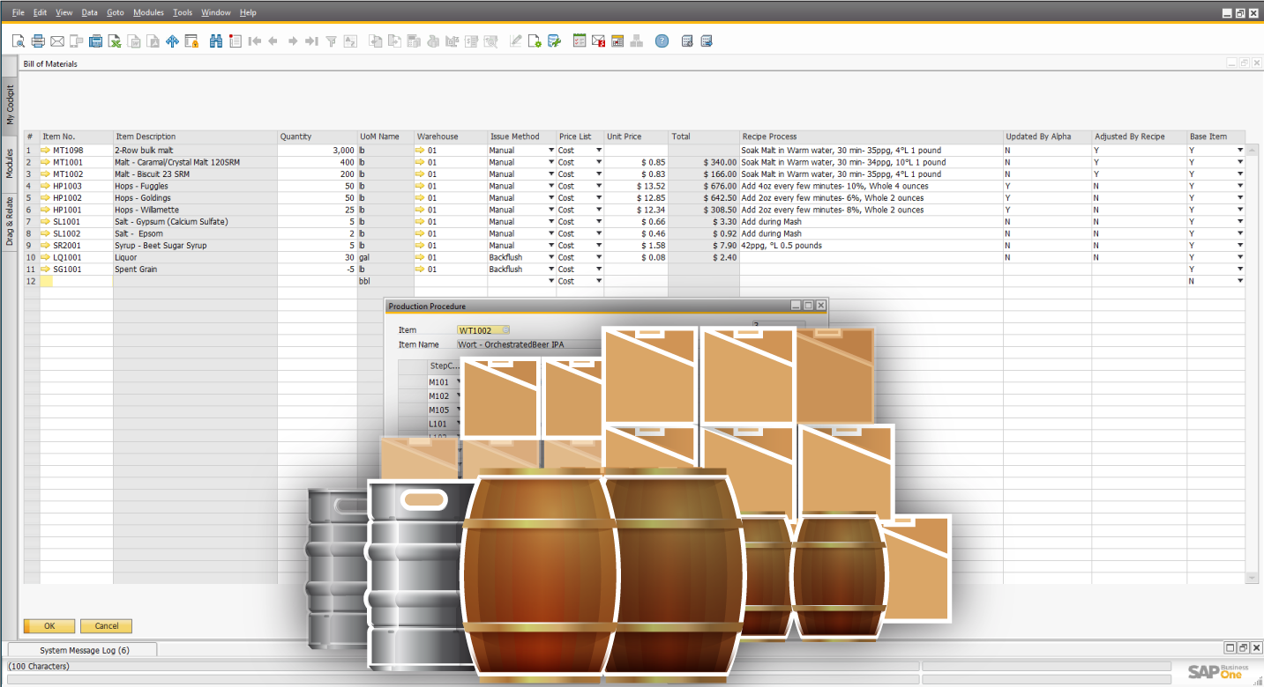
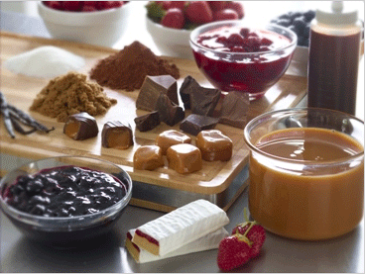
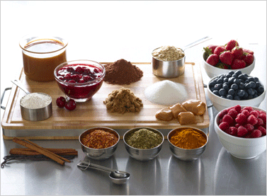
Ingredients control in manufacturing

Slide 8
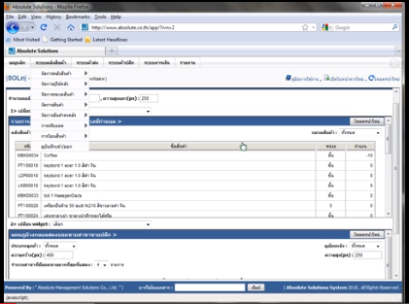
System Review
Absolute |Solution| website

Slide 9
Pros
All data is security from virus on machine.
The user can save investment.
Support using this web site with every operation system.
Support alert message with SMS and email.

Slide 10
Cons
Support only internet access areas.
No estimate the ingredients from ordering information.
No summary report system.

Slide 11
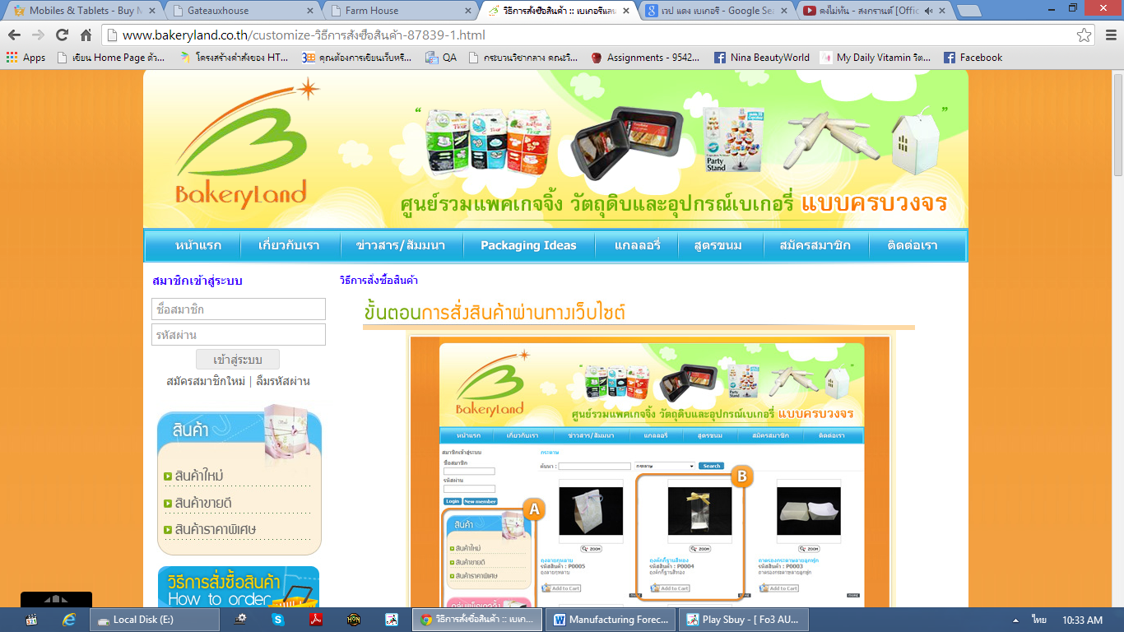
Bakery land website

Slide 12
Pros
The user can order the product through the website.
Have tutorial description for ordering.
Good category management.

Slide 13
Cons
Support only internet access areas.
No estimate the ingredients from ordering information.
No summary report system.

Slide 14
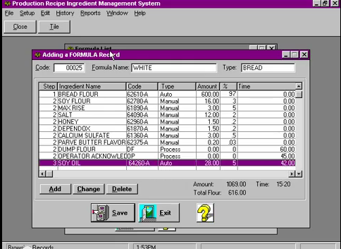
PRIMS Software

Slide 15
Pros
Easy to use for no user experience to operation.
Flexible technology to control over manual operation.
Record each step in the process.
Fast and accuracy.

Slide 16
Cons
No membership and login support.
No online interactive.
No coverage report type function.

Slide 17



Technology review

Slide 18



Development Tools Review

Slide 19
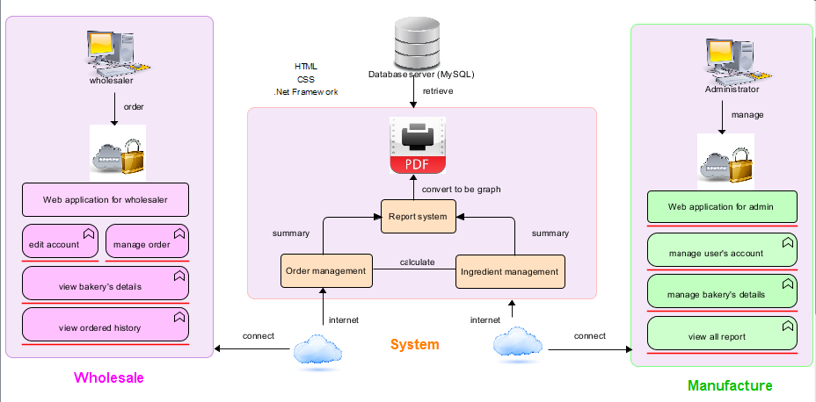
System Architecture

Slide 20
Limitation
This application required Internet connection to execute.
This application supports only Phungnoi bakery manufacturer as a sample for developing and testing the system.
This application cannot support stock and billing system.
This application cannot integrate directly with existing software.
This application require web browser.
This application require database server.

Slide 21
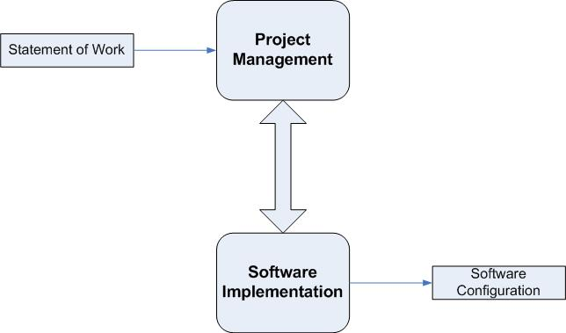
Quality & Assurance
ISO29110 for Very Small Entity (VSE)

Slide 22
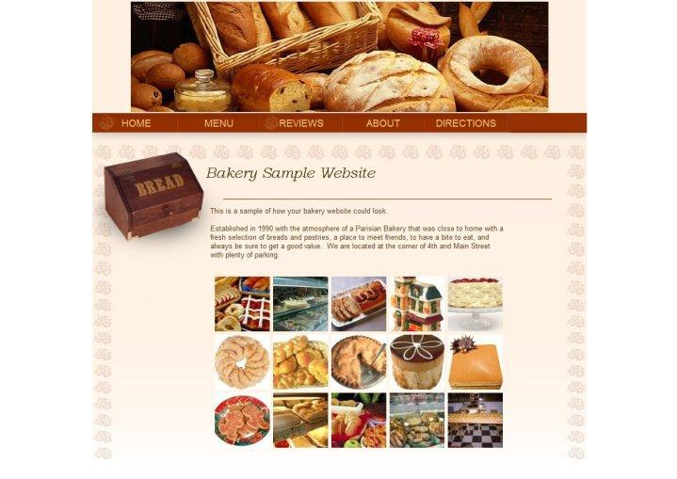

Objectives
Wholesaler ordering conveniently

Slide 23

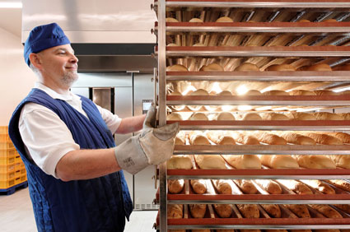


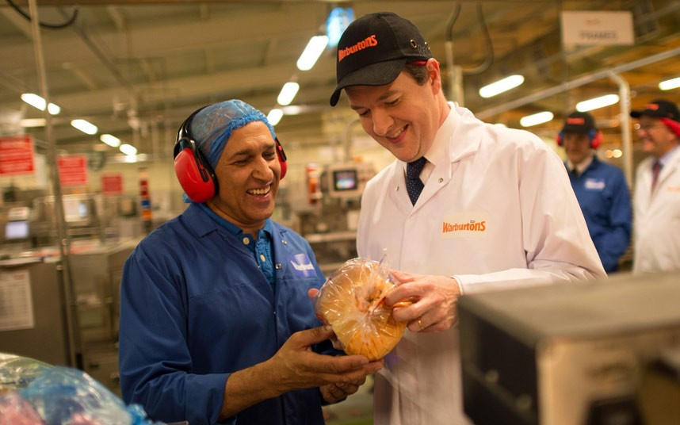
Support manufacture cooperation

Slide 24
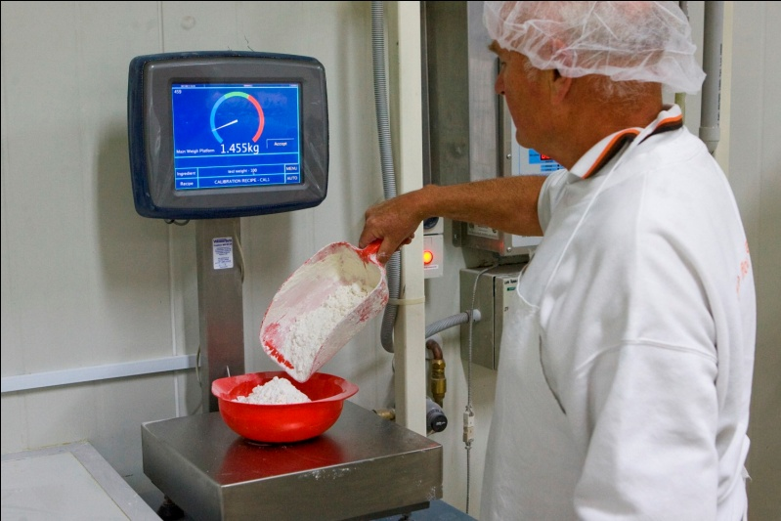
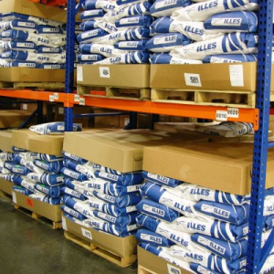
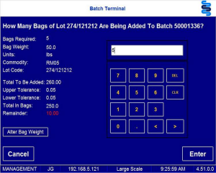
Control ingredients usage & standard

Slide 25
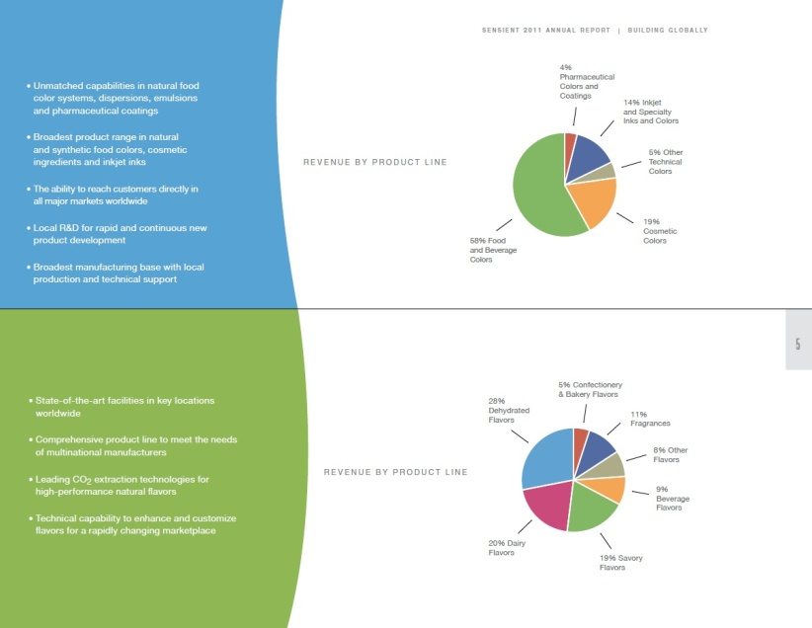
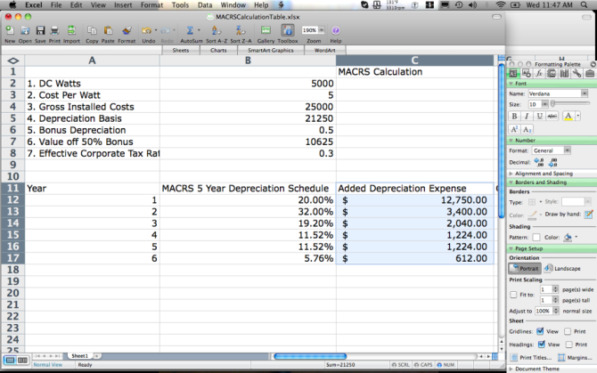

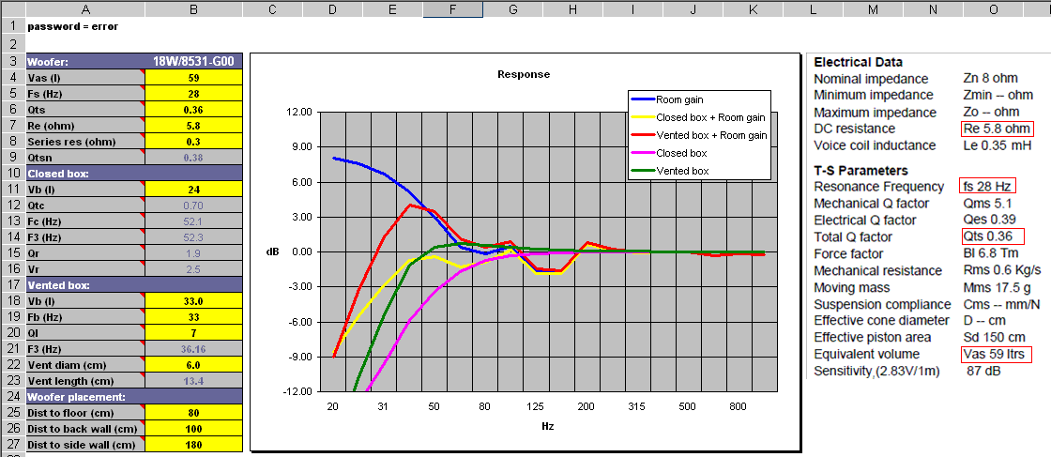
Manufacturer has any information’s report

Slide 26
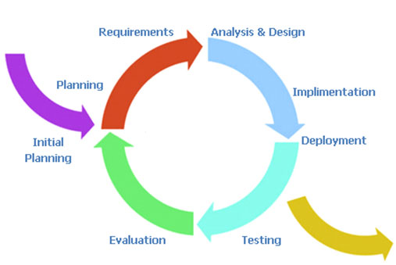
Development Model
Iterative Software Development Process
Develop a system through repeated cycles (iterative) and in smaller portions at a time (incremental)

Slide 27
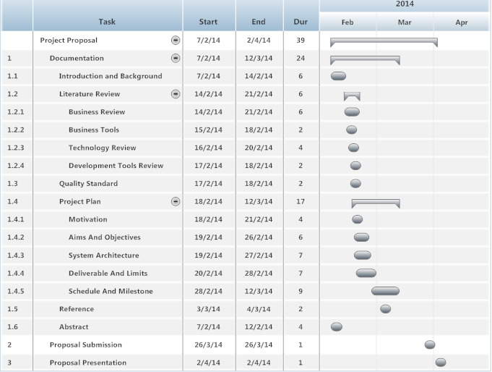
Schedule and Milestones
Proposal

Slide 28
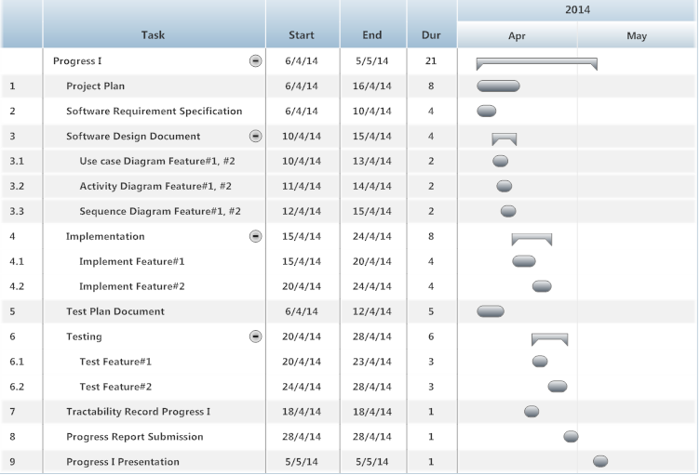
Progress I

Slide 29
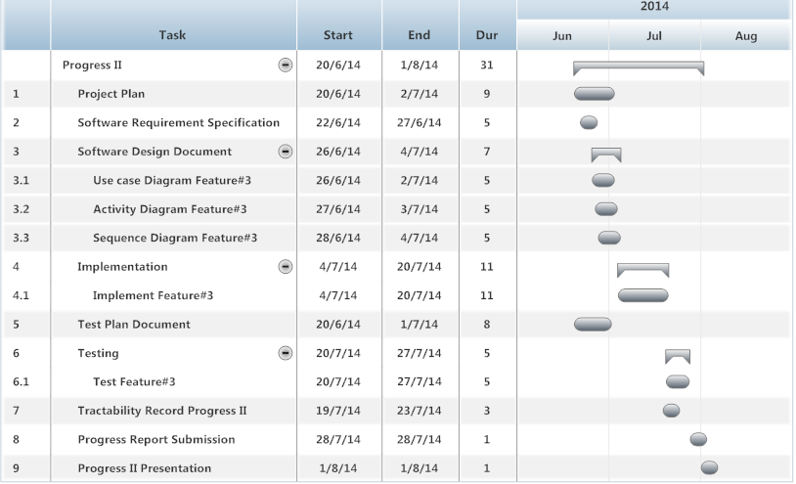
Progress II

Slide 30
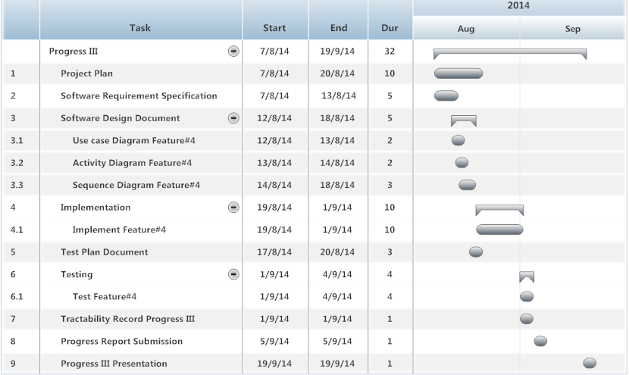
Progress III

Slide 31
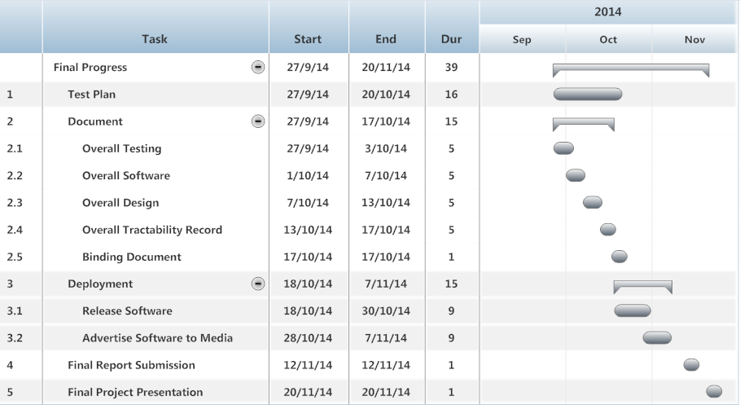
Final Progress

Slide 32

Q & A

